Slide 1
Remote Procedure Calls

Slide 2
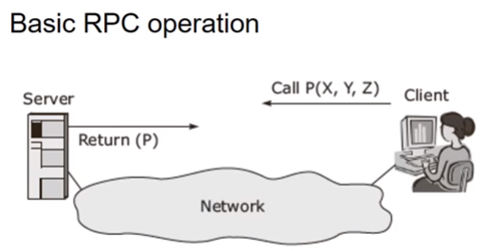
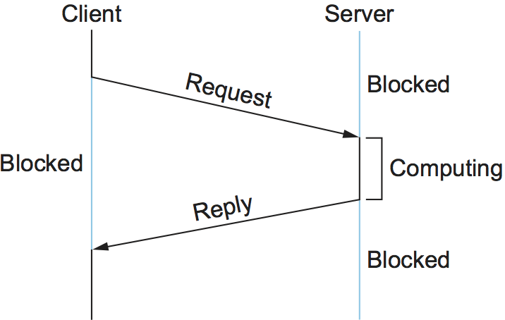
Remote Procedure Call
A common pattern of communication used by application programs structured as a client/server pair is the request/reply message transaction:
A client sends a request message to a server, and the server responds with a reply message, with the client blocking (suspending execution) to wait for the reply.
Figure illustrates the basic interaction between the client and server in such an exchange.

Slide 3
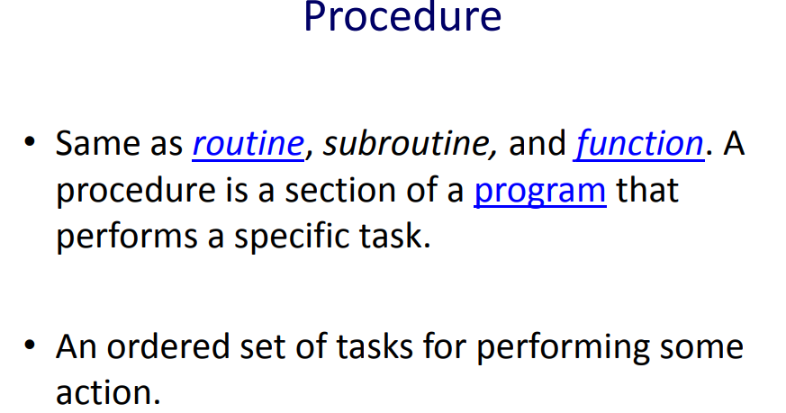

Slide 4
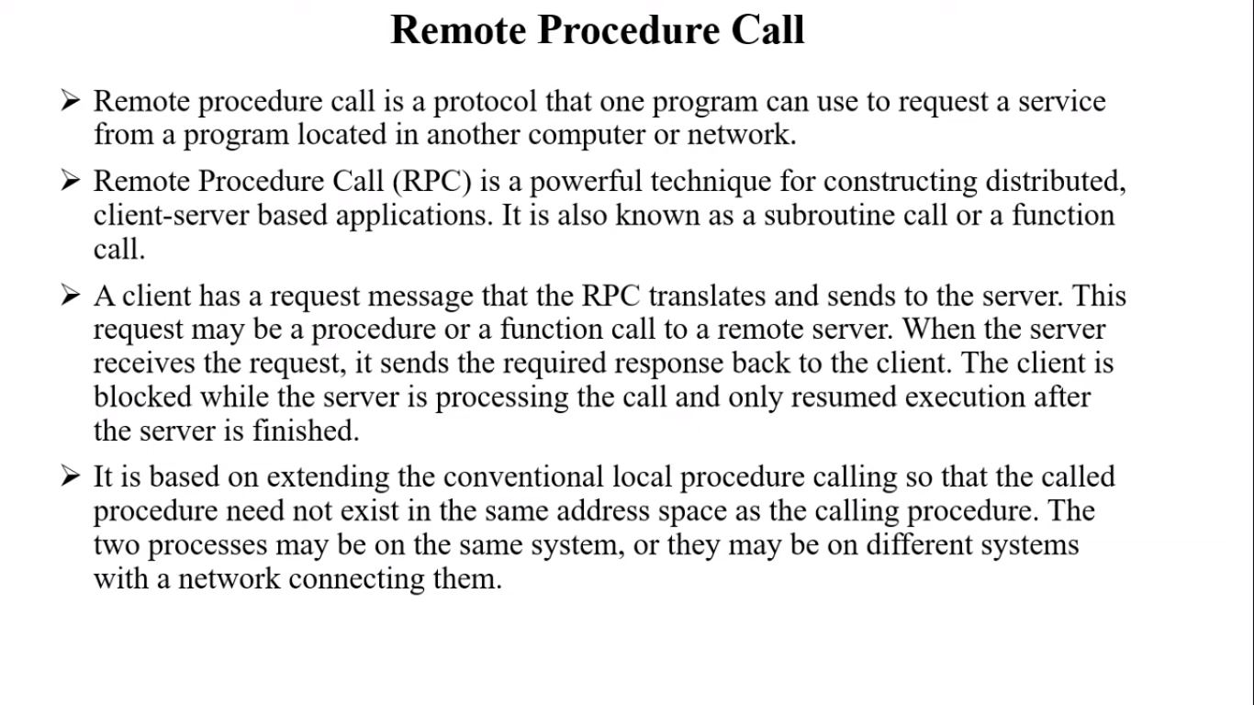

Slide 5
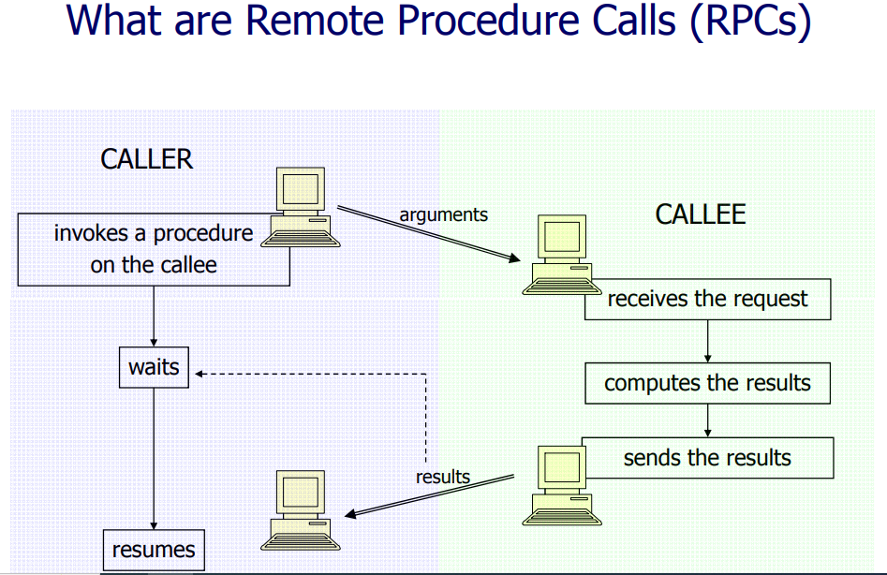
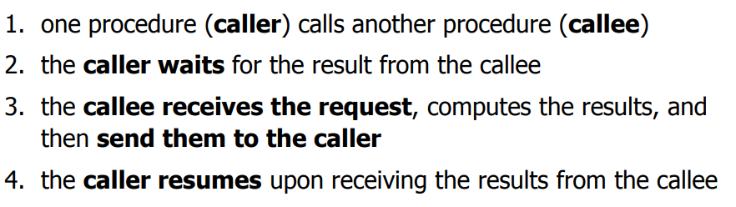

Slide 6
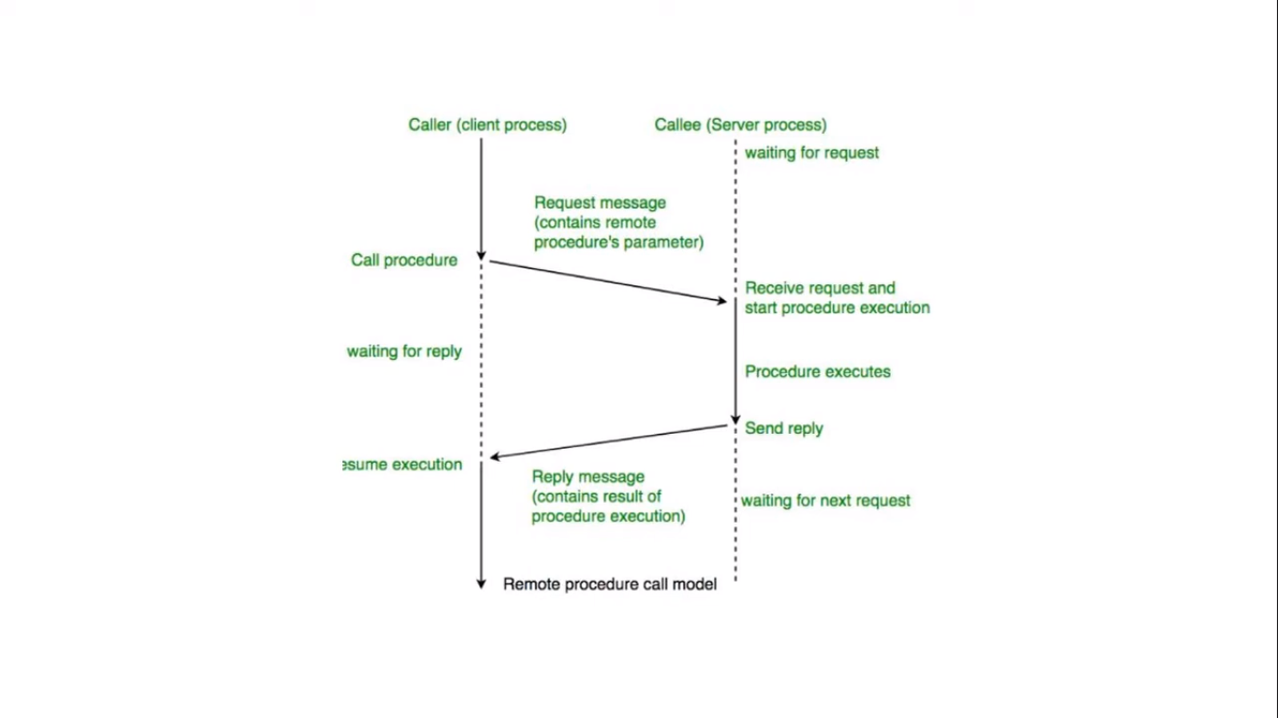

Slide 7
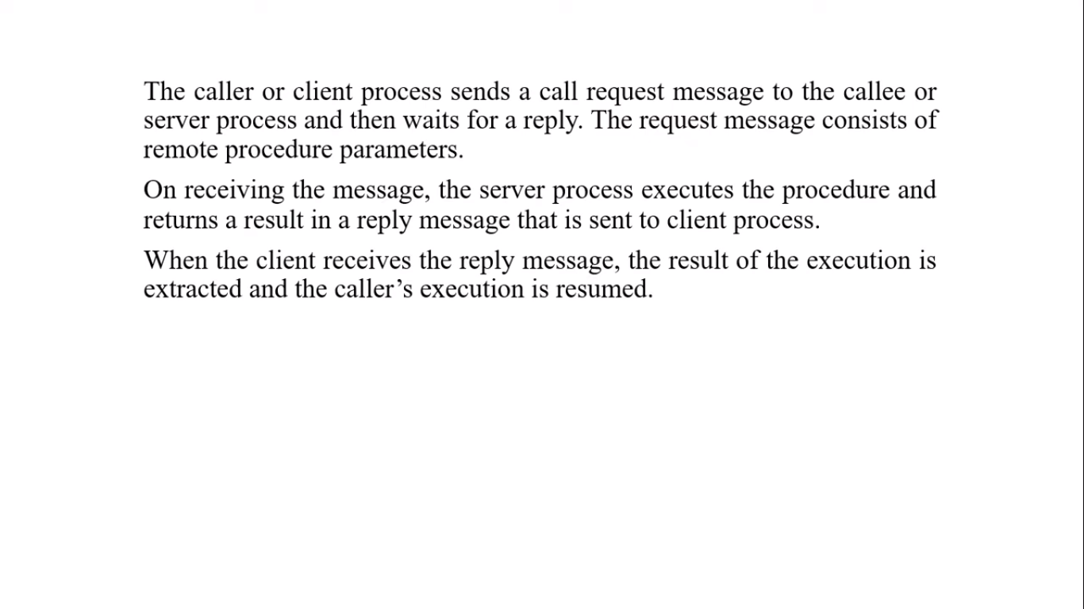

Slide 8
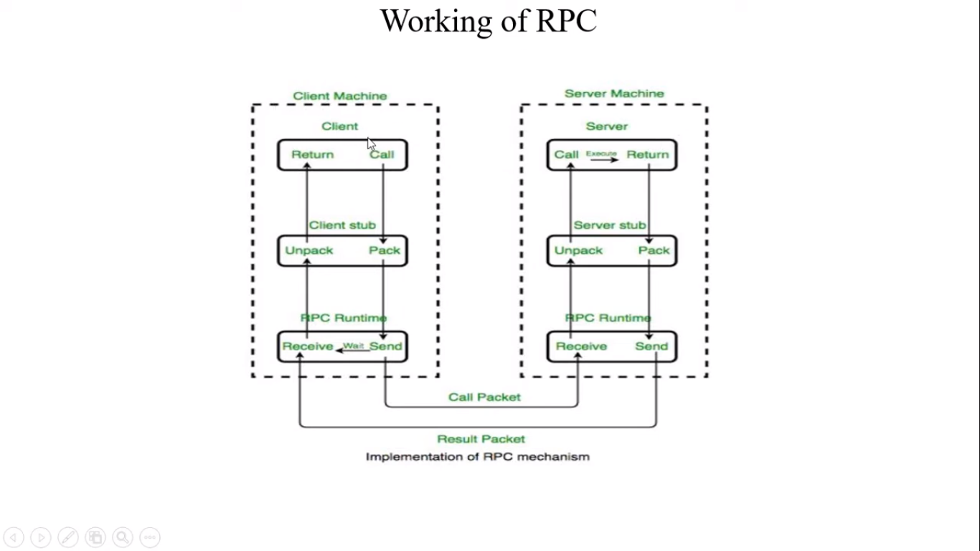

Slide 9
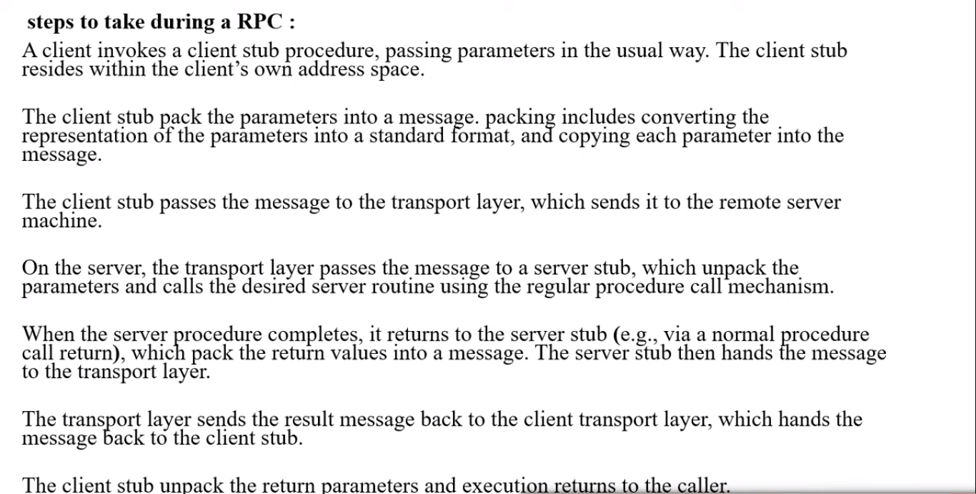

Slide 10
Client: The client process initiates RPC. The client makes a standard call, which triggers a correlated procedure in the client stub.
Client Stub: The client calls the client stub. Client stub does the following tasks:
The first task performed by client stub is when it receives a request from a client, it packs(marshalls) the parameters and required specifications of remote/target procedure in a message.
The second task performed by the client stub is upon receiving the result values after execution, it unpacks (unmarshalled) those results and sends them to the Client.

Slide 11
RPC Runtime: The RPC runtime is in charge of message transmission between client and server via the network.
Retransmission, acknowledgement, routing, and encryption are all tasks performed by it.
On the client-side, it receives the result values in a message from the server-side, and then it further sends it to the client stub whereas, on the server-side, RPC Runtime got the same message from the server stub when then it forwards to the client machine. It also accepts and forwards client machine call request messages to the server stub.
Server Stub: Server stub does the following tasks:
The first task performed by server stub is that it unpacks(unmarshalled) the call request message which is received from the local RPC Runtime and makes a regular call to invoke the required procedure in the server.
The second task performed by server stub is that when it receives the server’s procedure execution result, it packs it into a message and asks the local RPC Runtime to transmit it to the client stub where it is unpacked.

Slide 12
Server: After receiving a call request from the client machine, the server stub passes it to the server. The execution of the required procedure is made by the server and finally, it returns the result to the server stub so that it can be passed to the client machine using the local RPC Runtime.

Slide 13
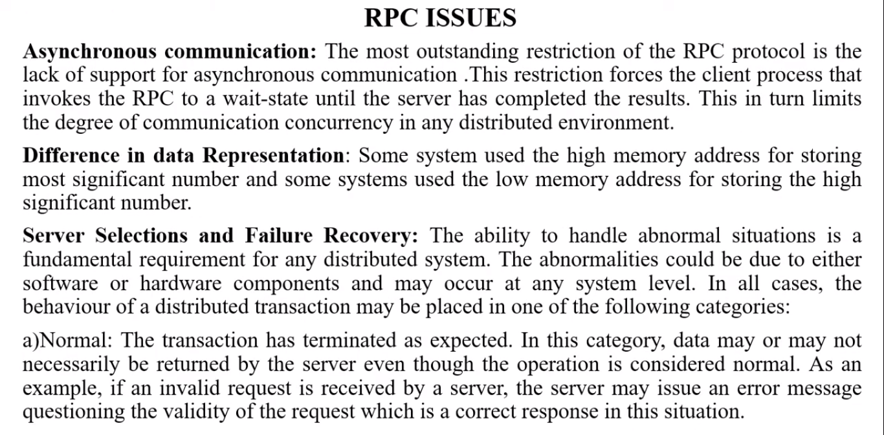

Slide 14
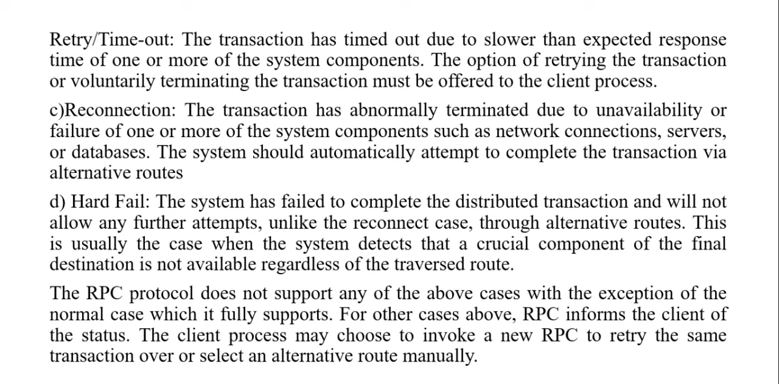

Slide 15
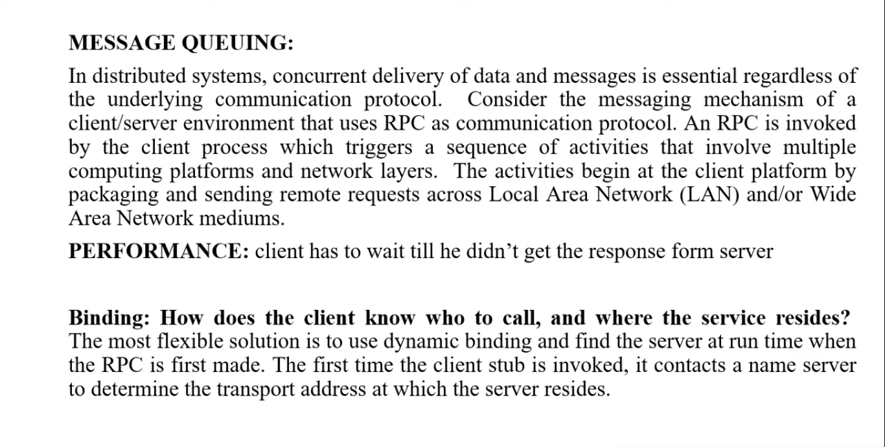

Slide 16
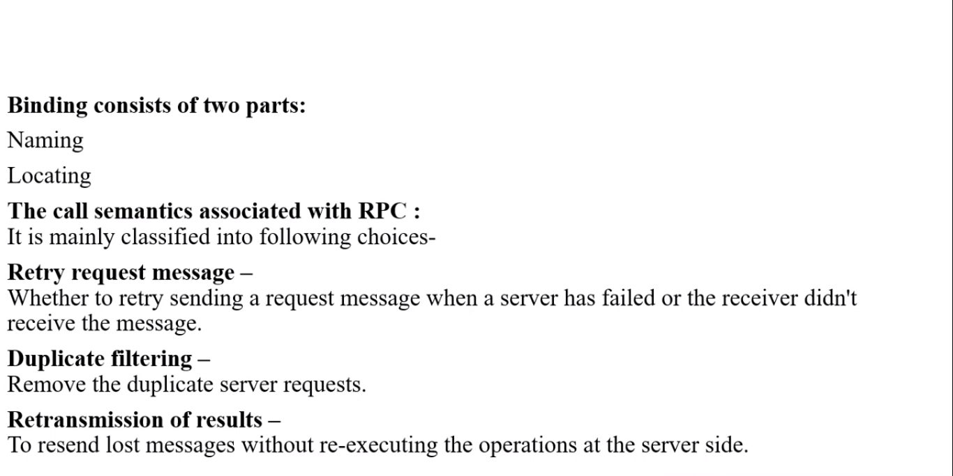

Slide 17
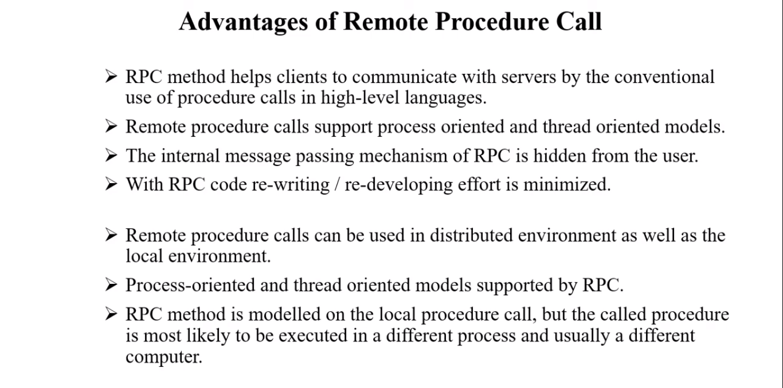

Slide 18
